Slide 1

Network Fundamentals
Network fundamentals part 2

Slide 2

Objectives:
Network speed calculations.
Network cabling classifications.
Network devices connectors/Modules.
Ethernet Cabling.
Challenging test.

Slide 3
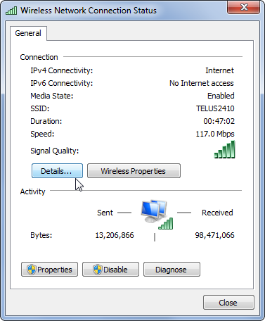
Network speed calculations:
When you see a network card speed set to 100 mbps for example, It means that It has the ability to move 100 megabit per second in/out the network card attached device.
Don’t let the difference between bit and byte confuse you, a byte has a set of 8 bits, where one bit could be only 0 or 1.
A file of 256 MB is to be sent from a file server to a file client, across which are connected through a C3750 switch together. According to network speeds (1 Gbps) from the server to the switch, and (100 mbps) from the client the switch, calculate how much time it takes for transferring file between the server and the client.

Slide 4
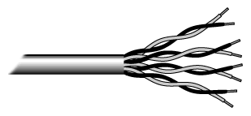
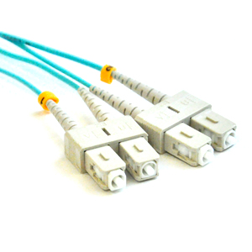
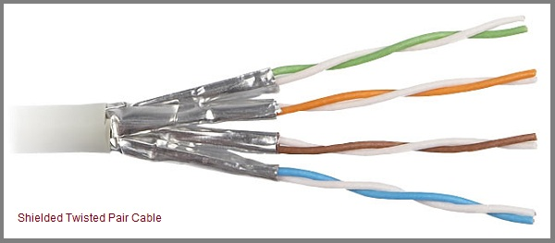
Network cabling classifications:
Let’s define the term “Ethernet”.
Three main types of cables are:
Twisted Pair Cables
Coaxial Cable
Fiber Cables
UTP
STP

Slide 5
Network cabling classifications:
Category | Maximum Speed | Maximum Signal Length
1 | 1mbps | None
N | 4mbps | None
3 | 10mbps | 100 meter
4 | 16mbps | 100 meter
5 | 10/100mbps | 100 meter
5e | 1Gbps | 100 meter
6 | 1Gbps | 100 meter
7 | 10Gbps | 100 meter
UTP Categories
Notice that maximum signal
lengths are approximated.
It may vary based on the service and the media surrounded the cable.

Slide 6
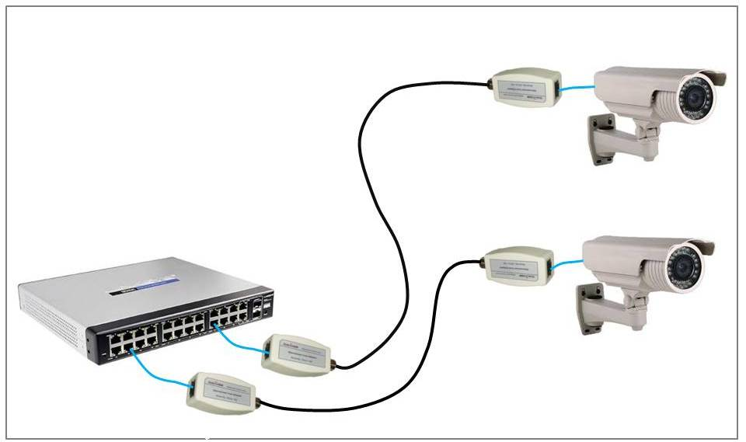
Network cabling classifications:
Cable type | Ω | Use
RG-6 | 75 | Video, TV
RG-8 | 50 | Radio, computer
RG-11 | 75 | Long runs
RG-58 | 50 | Radio, computer
RG-59 | 75 | Video, TV
Coaxial Categories

Slide 7
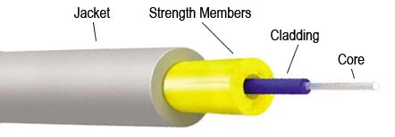
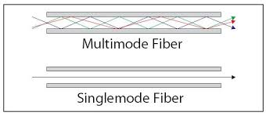
Network cabling classifications:
Single Mode
Multi Mode

Slide 8
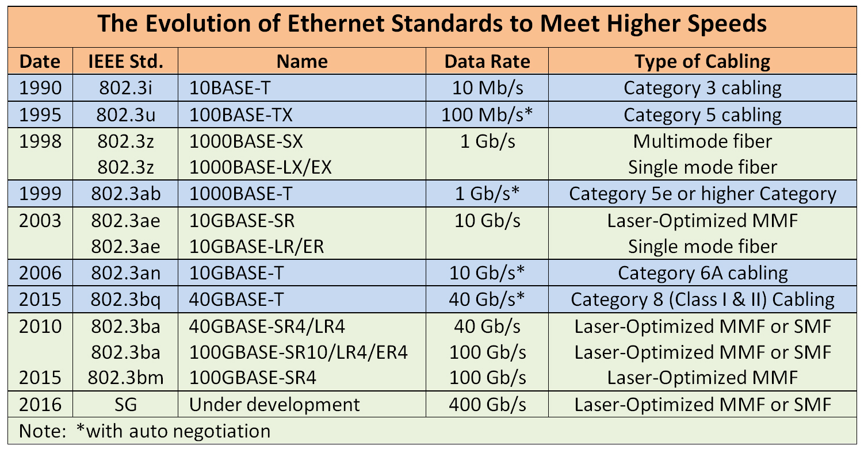
Network cabling classifications:

Slide 9
Network cabling classifications:
Standard | Cabling | Maximum length
1000BASE-CX | Twinaxial cabling | 25 Meter
100BASE-FX | Two strands, multimode | 400 Meter
1000BASE-LX | Long-wavelength laser, MM or SM fiber | 10 km (SM-Single-mode) 3 km (MM-Multimode)
1000BASE-SX | Short-wavelength laser, MM fiber | 220 Meter with 62.5-micron fiber 550 Meter with 50-micron fiber
1000BASE-ZX | Extended wavelength, SM fiber | 100 Km
Lock this table to your mind as It appears a lot in CCNA exams.

Slide 10
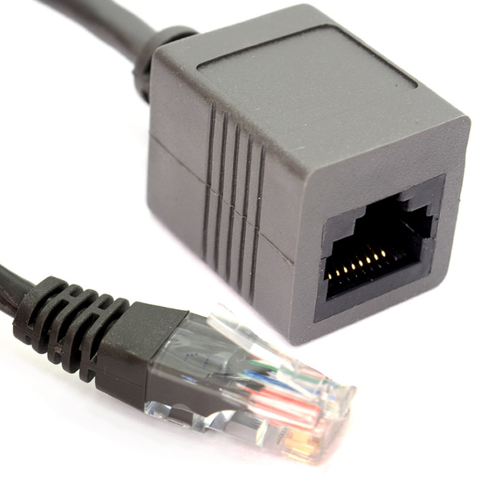
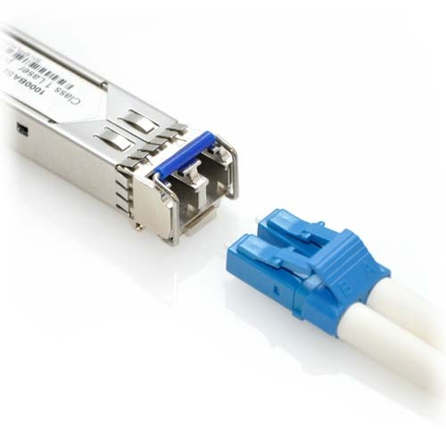
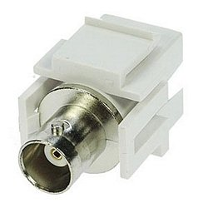
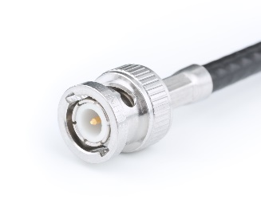
Network devices connectors:
RJ-45 Connector/Module
SFP Connector/Module
BNC Connector/Module

Slide 11
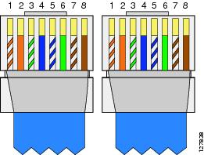
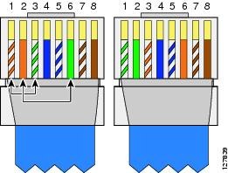
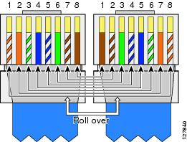
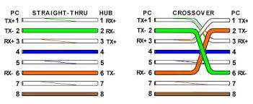
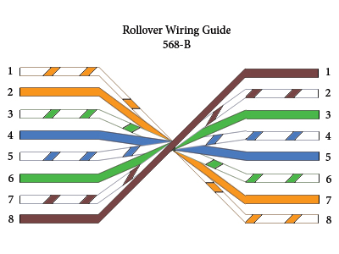
Ethernet cabling:
Straight-through cabling
Crossover cabling
Rolled cabling

Slide 12
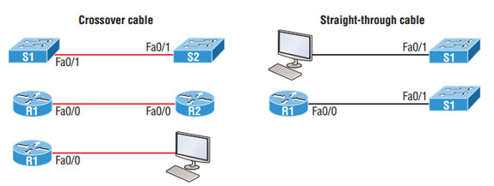
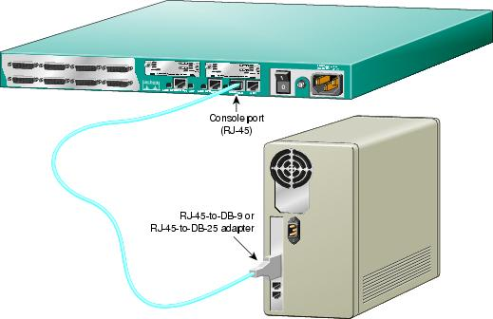
Ethernet cabling:
Straight-through cabling
Crossover cabling
Rolled cabling

Slide 13
Objectives:
Network speed calculations.
Network cabling classifications.
Network devices connectors/Modules.
Ethernet Cabling.
Challenging test.

Slide 14
CCNA Routing & Switching
Network fundamentals part 2

